Slide 1
Potion Shopkeeper
Prototype – Implementation stage
Zora Kerr

Slide 2
Potion Shopkeeper
The game
Development process
Remaining work

Slide 3

The game
Concept
UI
3D environment

Slide 4
The game
Concept
UI
3D environment
1 player
Side-scrolling
Point & click
Screen-space overlays
Title, main and settings menus
Drag & drop inventories
Unity primitive objects
Pre-existing assets
Iterated tutorial scripts
Notes:
In Potion Shopkeeper, the player is the potion maker of a small village and the game takes place in their house and garden. The player gathers ingredients from their garden, combines those ingredients in their laboratory to make potions, and gives those potions to villagers who present with varying problems. The player must experiment with different ingredients to make different potions which address the needs of the villagers.
Concept
1 player
Side-scrolling
Point & click cosy game with no fail state or loss criteria.
standalone PC application (Windows 10).
web browser (WebGL).
mobile phone (Android App Bundle).
UI
Screen-space overlays
Drag & drop inventories
Title, main and settings menus
3D environment
Unity primitive objects
Pre-existing assets from other sources
My own code scripts from iterative tutorials

Slide 5

Development process
Conceptual plan
UI development
Game development

Slide 6
Development process
Conceptual plan
UI development
Game development
Overall project plan (assessments 1-4)
Flowchart of all UI interactions
Cross-platform development tutorials
Building and installing
Monitoring and review
Work breakdown schedule
Timeline
UI tutorials
Cross-platform development tutorials
Notes:
Conceptual plan
My overall project plan addresses the 4 Cross-Platform Development assessments as one holistic task.
I have one master document from which I derive my other documents, such as the research workbook, technical design document, work breakdown schedule and timeline.
UI
The UI is derived from the gameplay loop – gathering ingredients from the garden and combining them in your laboratory to make potions.
The gameplay loop is underpinned by inventory drag & drop functions.
To make sure that I understood how the system should work, and to cement the learning from the UI tutorials, I made a flowchart of the interactions between the UI elements.
Game development

Slide 7
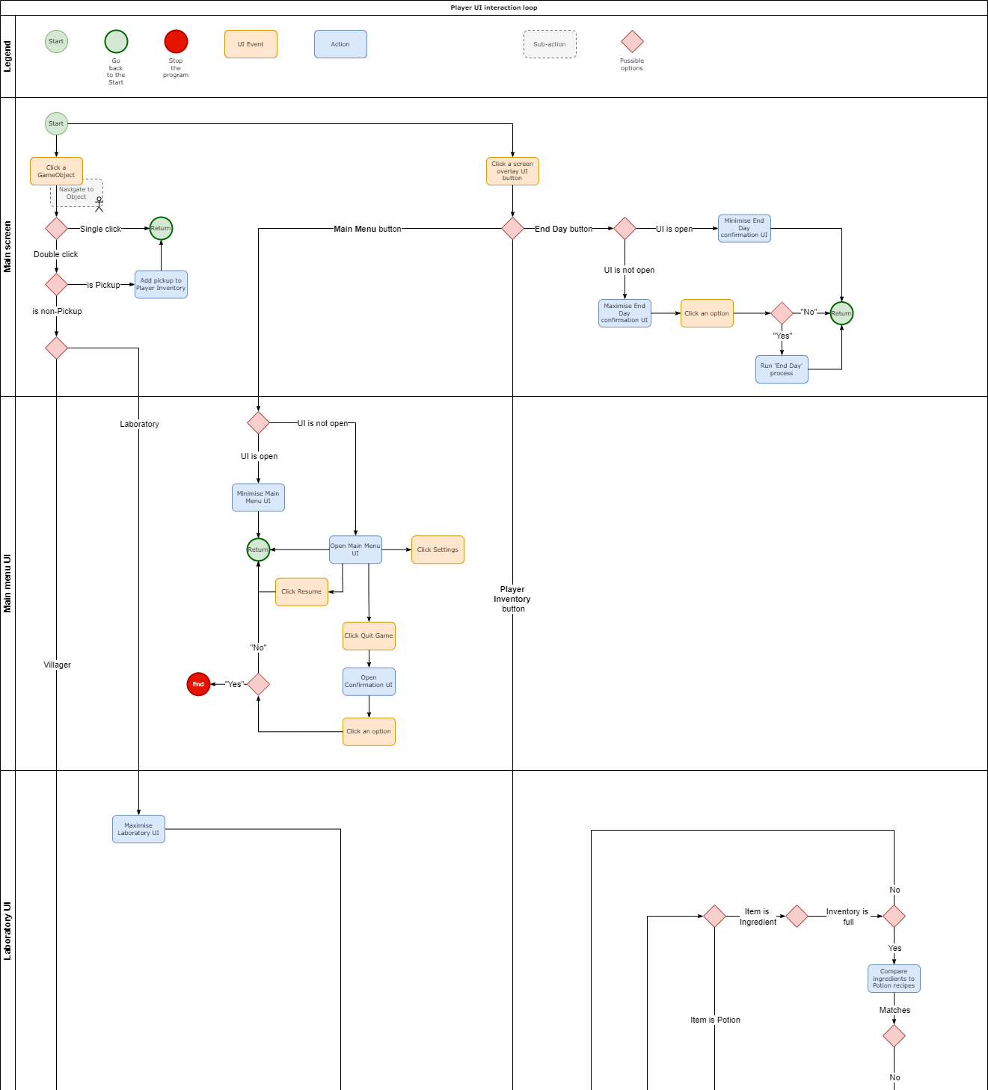
Development process
Notes:
This is one section of my UI flowchart which divides the UI into it broad events, triggers and logic choices according to the game object or UI element contextually affected.
This document is a two-way connecting bridge between the game, and my plan for the game, and all 3 of those pieces change with one another when I need to make updates.
the flowchart informs the game, and the game informs the flowchart, both of which inform the design.

Slide 8
Development process
Notes:
This is my high-level work breakdown structure, which divides the prototype into its parts according to the 4 assessments. Each assessment has its own activities which address different mandated requirements from the prototype’s marking rubric.

Slide 9

Remaining work
UI
3D environment
Build
Notes:
I have work remaining on the UI, the 3D environment, and the prototype build.

Slide 10
Remaining work
Notes:
Going back to my WBS, keeping track of where I’m up to on the project as a whole is easy, because I can track each of the deliverables and its progress.

Slide 11
Remaining work
Notes:
In green we have activities which are complete, and in yellow, activities which aren’t. For example I can see that for the visual effects tutorial, the tutorial is complete, but I haven’t built and tested it on mobile yet, so I can’t submit it.
By contrast, assessment 3 has all of its minimum content requirements in place, but you can see that I haven’t submitted the assessment on Canvas. This is because the content is currently disaggregated over a couple of different documents which I need to merge together, and the TDD will continue to evolve and change right up until the prototype is complete and built.

